Slide 1

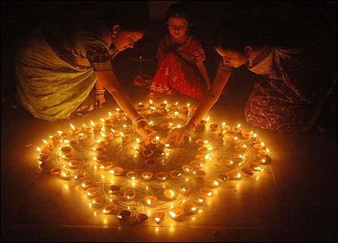
Indian Cultures
This app is based on our Indian Cutures and Traditions
Cultures like
Festivals
Homes, buildings and temples are decorated with festive lights, diya, for Diwali, the festival of lights

Slide 2
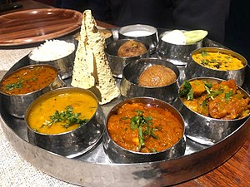
Foods
Indian food is as diverse as India. Indian cuisines use numerous ingredients, deploy a wide range of food preparation styles, cooking techniques, and culinary presentations. From salads to sauces, from vegetarian to meat, from spices to sensuous, from bread to desserts, Indian cuisine is invariably complex. Harold McGee, a favourite of many Michelin-starred chefs, writes "for sheer inventiveness with the milk itself as the primary ingredient, no country on earth can match India

Slide 3
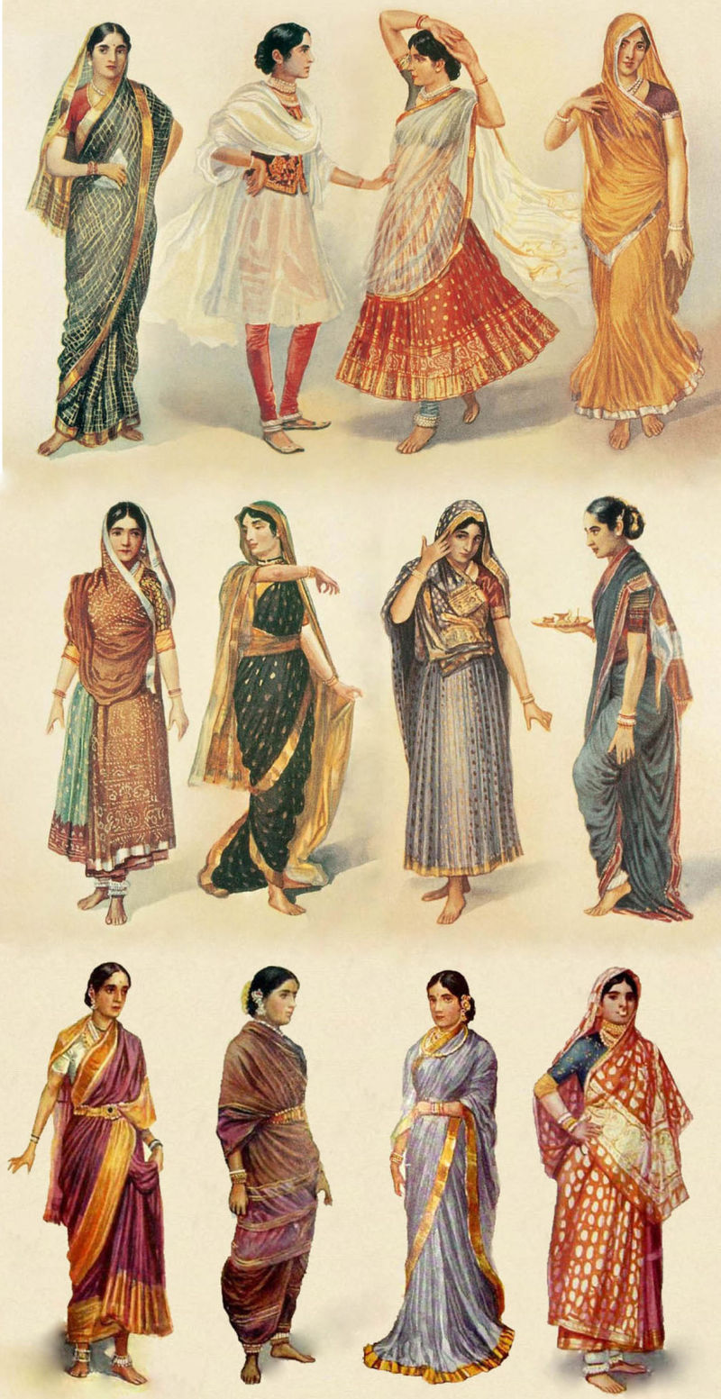
Clothing
Traditional clothing in India greatly varies across different parts of the country and is influenced by local culture, geography, climate, and rural/urban settings. Popular styles of dress include draped garments such as sari and mekhela sador for women and dhoti or lungi or panche (in Kannada) for men. Stitched clothes are also popular such as churidar or salwar-kameez for women, with dupatta (long scarf) thrown over shoulder completing the outfit. The salwar is often loose fitting, while churidar is a tighter cut.^{[110]} The dastar, a headgear worn by Sikhs is common in Punjab.

Slide 4
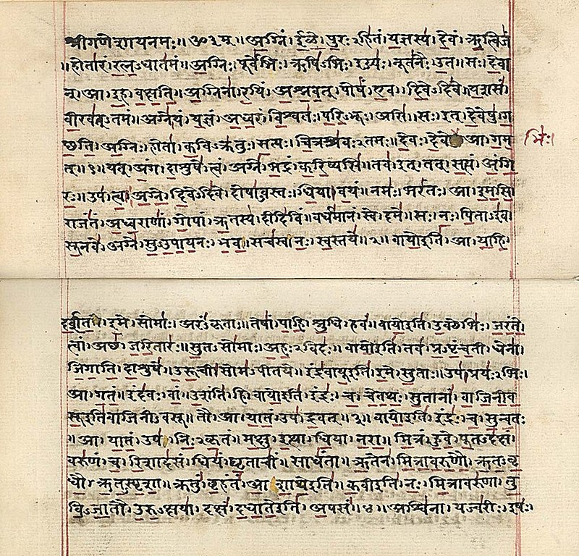
language and literature
The Sanskrit language, whatever be its antiquity, is of a wonderful structure; more perfect than the Greek, more copious than the Latin, and more exquisitely refined than either, yet bearing to both of them a stronger affinity, both in the roots of verbs and the forms of grammar, than could possibly have been produced by accident; so strong indeed, that no philologer could examine them all three, without believing them to have sprung from some common source, which, perhaps, no longer exists; there is a similar reason, though not quite so forcible, for supposing that both the Gothic and the Celtic, though blended with a very different idiom, had the same origin with the Sanskrit ...

Slide 5
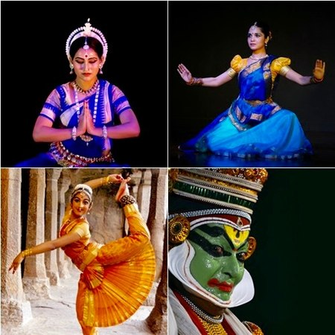
Performing arts - Dance,Drama,Puppetry,Shadow Play
Let drama and dance (Nātya, नाट्य) be the fifth vedic scripture. Combined with an epic story, tending to virtue, wealth, joy and spiritual freedom, it must contain the significance of every scripture, and forward every art.
— First chapter of Nātyaśāstra, sometime between 200 BCE – 200 CE.^{[142][143]}
India has had a long romance with the art of dance. The Hindu Sanskrit texts Natya Shastra (Science of Dance) and Abhinaya Darpana (Mirror of Gesture) are estimated to be from 200 BCE to early centuries of the 1st millennium CE.^{[143][144][145]}
The Indian art of dance as taught in these ancient books, according to Ragini Devi, is the expression of inner beauty and the divine in man.^{[146]} It is a deliberate art, nothing is left to chance, each gesture seeks to communicate the ideas, each facial expression the emotions

Slide 6
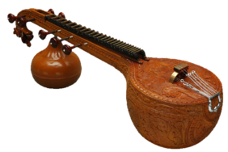
music
Music is an integral part of India's culture. Natyasastra, a 2000-year-old Sanskrit text, describes five systems of taxonomy to classify musical instruments.^{[165]} One of these ancient Indian systems classifies musical instruments into four groups according to four primary sources of vibration: strings, membranes, cymbals, and air. According to Reis Flora, this is similar to the Western theory of organology. Archeologists have also reported the discovery of a 3000-year-old, 20-key, carefully shaped polished basalt lithophone in the highlands of Odisha.^{[166]}

Slide 7
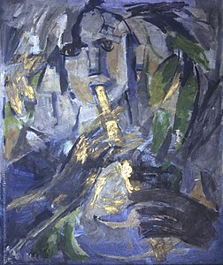
painting
Cave paintings from Ajanta, Bagh, Ellora and Sittanavasal and temple paintings testify to a love of naturalism. Most early and medieval art in India is Hindu, Buddhist or Jain. A freshly made coloured floor design (Rangoli) is still a common sight outside the doorstep of many (mostly South Indian) Indian homes. Raja Ravi Varma is one of the classical painters from medieval India.
Pattachitra, Madhubani painting, Mysore painting, Rajput painting, Tanjore painting and Mughal painting are some notable Genres of Indian Art; while Nandalal Bose, M. F. Husain, S. H. Raza, Geeta Vadhera, Jamini Roy and B. Venkatappa^{[171]} are some modern painters. Among the present day artists, Atul Dodiya, Bose Krishnamacnahri, Devajyoti Ray and Shibu Natesan represent a new era of Indian art where global art shows direct amalgamation with Indian classical styles. These recent artists have acquired international recognition. Jehangir Art Gallery in Mumbai, Mysore Palace has on display a few good Indian paintings.

Slide 8
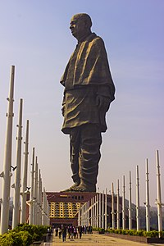
sculpture
The Statue of Unity is the world's tallest statue, with a height of 182 metres (597 feet), located in the state of Gujarat.It depicts Indian statesman and independence activist Vallabhbhai Patel (1875–1950), who was the first deputy prime minister and home minister of independent India. It was inaugurated by the Prime Minister of India, Narendra Modi, on 31 October 2018.

Slide 9
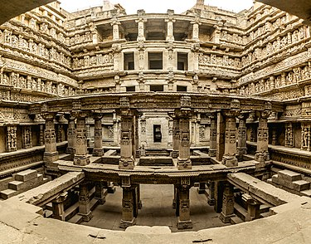
architecture
Indian architecture encompasses a multitude of expressions over space and time, constantly absorbing new ideas. The result is an evolving range of architectural production that nonetheless retains a certain amount of continuity across history. Some of its earliest production are found in the Indus Valley civilisation (2600–1900 BC) which is characterised by well-planned cities and houses. Religion and kingship do not seem to have played an important role in the planning and layout of these towns.

Slide 10

sports
Field hockey was considered to be the national game of India, but this has been recently denied by the Government of India, clarifying on a Right to Information Act (RTI) filed that India has not declared any sport as the national game.^{[179][180][181]} At a time when it was especially popular, the India men's national field hockey team won the 1975 Men's Hockey World Cup, and 8 gold, 1 silver, and 2 bronze medals at the Olympic Games. However, field hockey in India no longer has the following that it once did.

Slide 11
Perceptions of Indian Culture
India's diversity has inspired many writers to pen their perceptions of the country's culture. These writings paint a complex and often conflicting picture of the culture of India. India is one of the most ethnically and religiously diverse countries in the world. The concept of "Indian culture" is a very complex and complicated matter. Indian citizens are divided into various ethnic, religious, caste, linguistic and regional groups, making the realities of "Indianness" extremely complicated. This is why the conception of Indian identity poses certain difficulties and presupposes a series of assumptions about what concisely the expression "Indian" means. However, despite this vast and heterogeneous composition, the creation of some sort of typical or shared Indian culture results from some inherent internal forces (such as a robust Constitution, universal adult franchise, flexible federal structure, secular educational policy, etc.) and from certain historical events (such as Indian Independence Movement, Partition, wars against Pakistan, etc.) Hindu Sanskriti Ankh is an ancient series of books originally from northern part of India highlighting the Bharatiya sanskriti, that is, the culture of India.
According to industry consultant Eugene M. Makar, for example, traditional Indian culture is defined by a relatively strict social hierarchy. He also mentions that from an early age, children are reminded of their roles and places in society.[207] This is reinforced, Makar notes, by the way, many believe gods and spirits have an integral and functional role in determining their life. Several differences such as religion divide the culture. However, a far more powerful division is the traditional Hindu bifurcation into non-polluting and polluting occupations. Strict social taboos have governed these groups for thousands of years, claims Makar. In recent years, particularly in cities, some of these lines have blurred and sometimes even disappeared. He writes important family relations extend as far as 1 gotra, the mainly patrilinear lineage or clan assigned to a Hindu at birth. In rural areas & sometimes in urban areas as well, it is common that three or four generations of the family live under the same roof. The patriarch often resolves family issues.[207]

